Slide 1
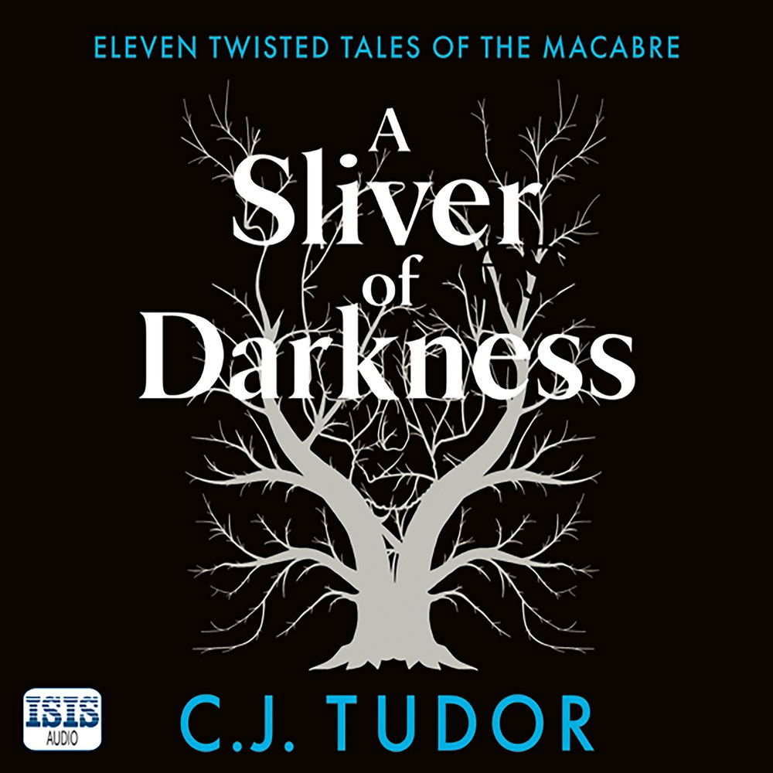
A Sliver Of Darkness
C.J. Tudor

Slide 2
A Sliver Of Darkness
C.J. Tudor

