Slide 1
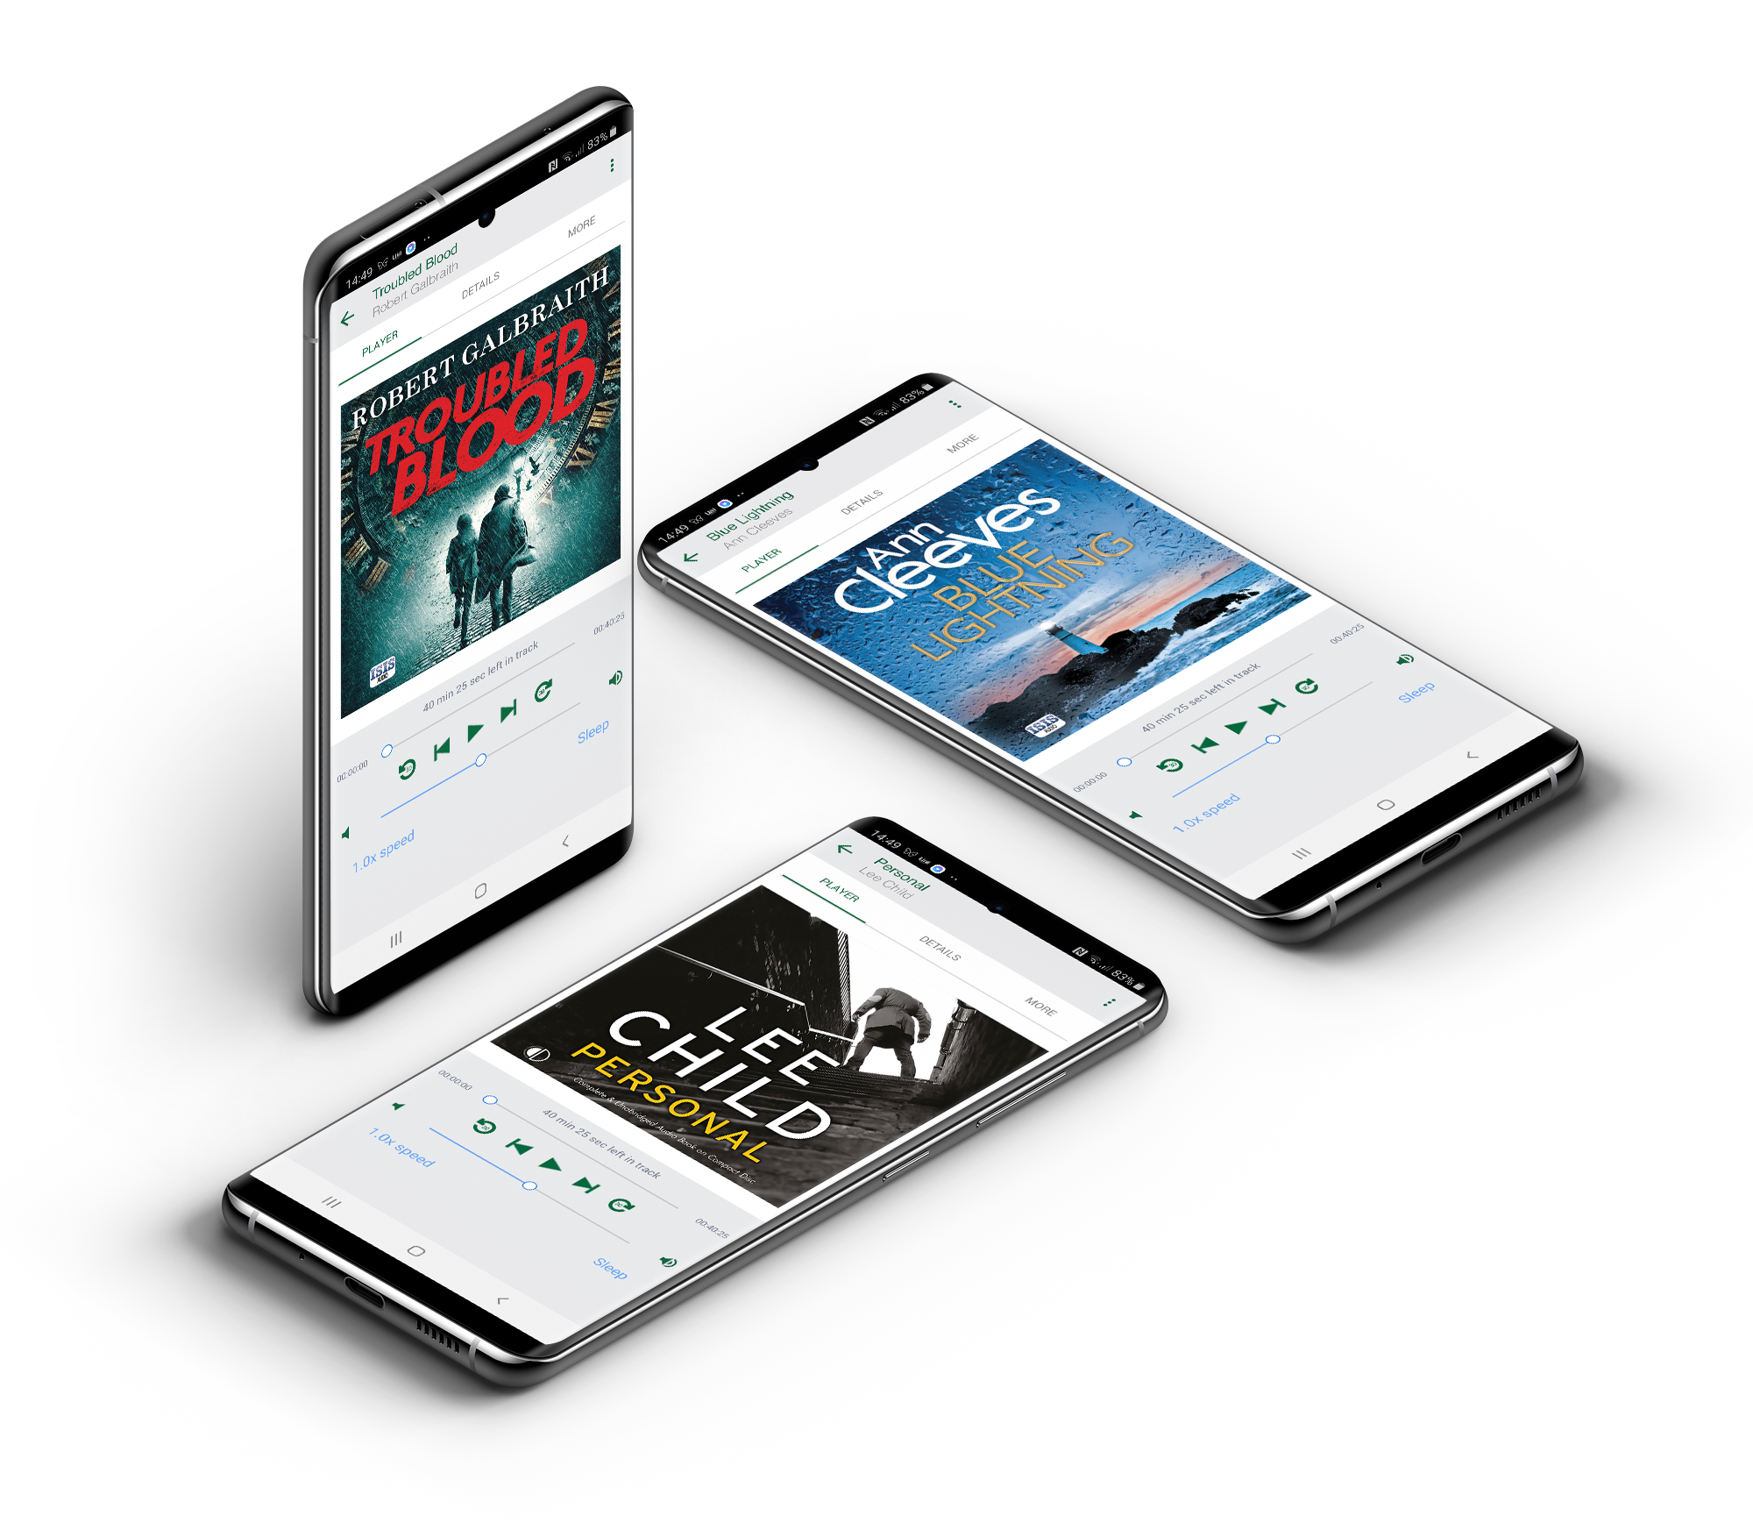

Join our uLibrary demo day
Discover a new way to experience your favourite books.
Day ^{th} Month
Start am – End pm
Library Name
Library Address

